Slide 1
Project Name - Instagram User Analytics
Description of the Project :
This project is based on world’s well known social media platform Instagram which is owned by Meta Platforms. It allow users to upload media files like photos and video clips on Instagram application and the posts can be shared publicly or with preapproved followers.
In this project, my role is to analyze the user interactions and engagement with the Instagram application and based on this, provide the valuable insights that can help grow the business.
In order to get the insights from the data, I first need to access the data from the database. So, I have used MySQL Workbench as my tool to retrieve the required data from the database.

Slide 2
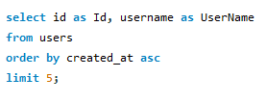
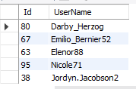
Approach used for the Project :
To extract the data from the Database, I have used a popular tool ie., MySQL Workbench. In this tool, I have accessed the various tables in the database and integrated them using join methods and gathered my required data using those queries.
I had various tasks which were guided me to get the required insights from the Instagram app.
----- Using the MySQL query, I found the top 5 oldest users on Instagram.
Query -
Output -

Slide 3
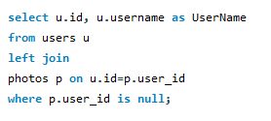
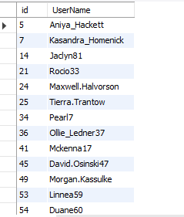
---- In order to encorage the inactive users to start posting on Instagram by sending them the promotional emails, I found the users on Instagram who had never posted a single photo on the app.
Query -
Output -
So, I have found total of 26 inactive users who have never posted a photo.

Slide 4
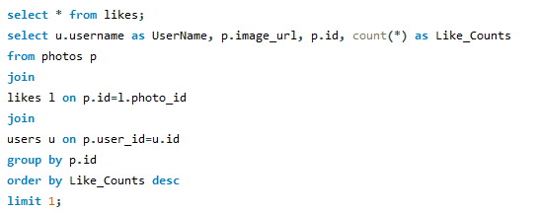

---- The team has organized a contest where the user with the most likes on a single photo wins.
So, I found the winner of the contest.
Query -
Output -
Zack_Kemmer93 is the username having total of 48 likes won the contest.

Slide 5
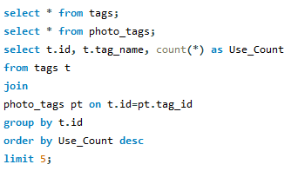
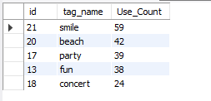
A partner brand wants to know the most popular hashtags to use in their posts to reach the most people.
Here, I have Identified and suggested the top five most commonly used hashtags on the platform.
Query -
Output -

Slide 6

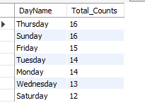
The team wants to know the best day of the week to launch ads.
So, I have determined the day of the week when most users register on Instagram.
Query -
Output -
So, from the output, Thursday and Sunday are the 2 days of the week, when most
Users register on Instagram.

Slide 7
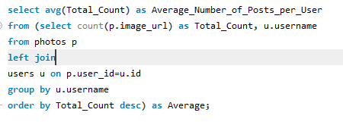


Investors want to know if users are still active and posting on Instagram or if they are making fewer posts.
So, I have calculated the average number of posts per user on Instagram.
Query -
Output -
3.47 posts is the average number of posts per user do on Instagram.
Also, I have provided the total number of photos on Instagram divided by the total number of users.
Query -
Output -

Slide 8


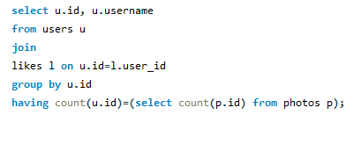
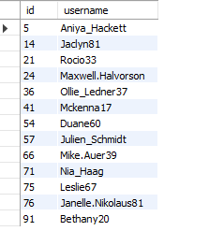
Investors want to know if the platform is crowded with fake and dummy accounts.
So, I have Identified users who have liked every single photo on the site, as this is not typically possible for a normal user.
I found a total of 13 users who are having fake and dummy accounts.

